Slide 1

COMPUTER NETWORKS
(BCSC 0008)
Copyright content, use only with the written permission of presenter mentioned
Lecture 21

Slide 2
Text and Reference Books
Text Books:
Fourouzan B. A. (2004), “Data Communication and Networking”, 4th Edition, McGraw-Hill.
References:
Kurose, J. F. and Ross K. W. (2005), “Computer Networking: A Top-Down Approach Featuring the Internet”, 3rd Edition, Addison-Wesley.
A. S. Tanenbaum (2006), “Computer Networks”, 2nd Edition, Prentice Hall India.

Slide 3
Basics
The IPv4 addresses are unique and universal.
An IPv4 address is 32 bits long.
The address space of IPv4 is 2³² (4,294,967,296)
32 bit address is divided into 4 octet ( also known as byte)
To connect on internet each device requires a unique IP address

Slide 4
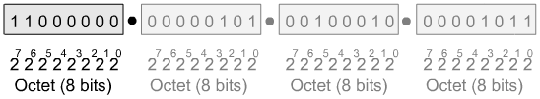
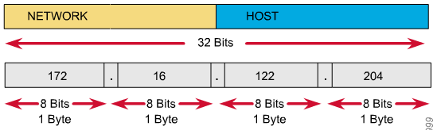
IP Address as a 32-Bit Binary Number ( Four Octet )
IPv4 Addressing

Slide 5
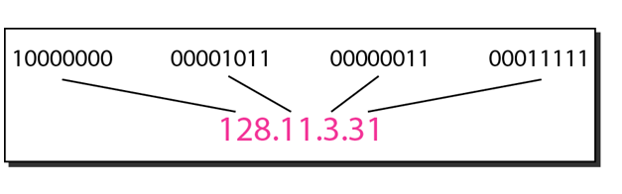
Binary to DDN conversion

Slide 6
Example 1
Change the following IPv4 addresses from binary notation to dotted-decimal notation.
a. 10000001 00001011 00001011 11101111
b. 11000001 10000011 00011011 11111111
c. 11100111 11011011 10001011 01101111
d. 11111001 10011011 11111011 00001111

Slide 7
Example 1 Solution
Change the following IPv4 addresses from binary notation to dotted-decimal notation.
a. 10000001 00001011 00001011 11101111
b. 11000001 10000011 00011011 11111111
c. 11100111 11011011 10001011 01101111
d. 11111001 10011011 11111011 00001111
Solution
We replace each group of 8 bits with its equivalent decimal number (see Appendix B) and add dots for separation:
a. 129.11.11.239
b. 193.131.27.255
c. 231.219.139.111
d. 249.155.251.15

Slide 8
Example 2
Change the following IPv4 addresses from dotted-decimal notation to binary notation.
a. 111.56.45.78
b. 221.34.7.82
c. 241.8.56.12
d. 75.45.34.78

Slide 9
Example 2 Solution
Change the following IPv4 addresses from dotted-decimal notation to binary notation.
a. 111.56.45.78
b. 221.34.7.82
c. 241.8.56.12
d. 75.45.34.78
Solution
We replace each decimal number with its binary equivalent:
a. 01101111 00111000 00101101 01001110
b. 11011101 00100010 00000111 01010010
c. 11110001 00001000 00111000 00001100
d. 01001011 00101101 00100010 01001110

Slide 10
Example 3
Find the error, if any, in the following IPv4 addresses:
a. 111.56.045.78
b. 221.34.7.8.20
c. 75.45.301.14
d. 11100010.23.14.67
Solution
a. There should be no leading zeroes (045).
b. We may not have more than 4 bytes in an IPv4 address.
c. Each byte should be less than or equal to 255.
d. A mixture of binary notation and dotted-decimal notation.

Slide 11
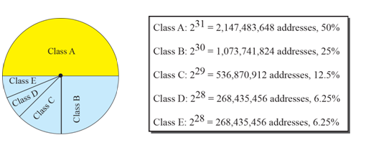
IPv4 Addressing Classification
IPv4 addresses can be classified on 2 ways:
Classful Addressing
Classless Addressing
In classful addressing, the address space is divided into five classes:
A, B, C, D, and E.

Slide 12
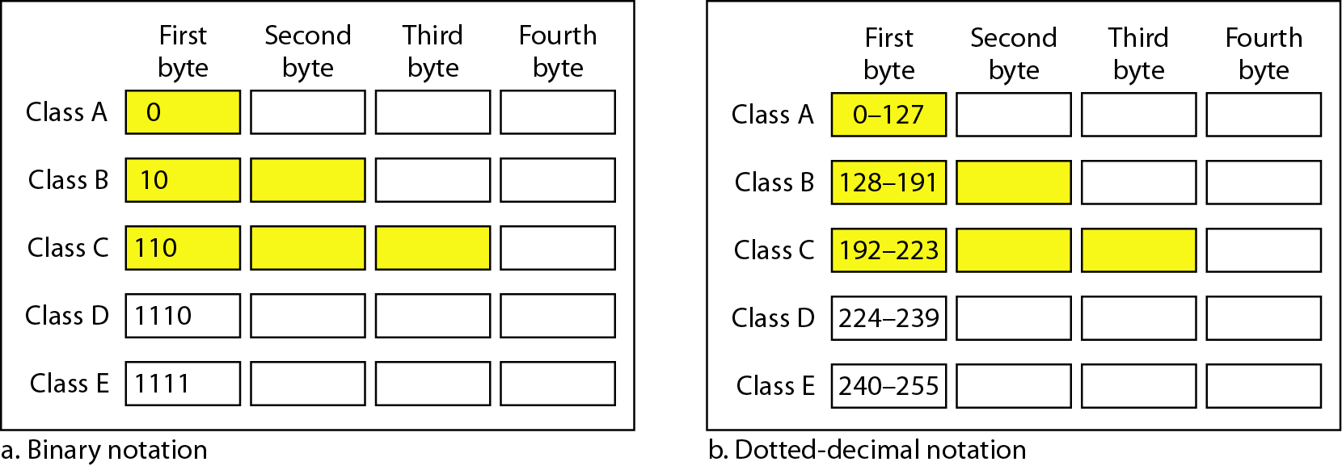
Classful Addressing
In classful addressing, the address space is divided into five classes: A, B, C, D, and E.

Slide 13
Example 19.4
Find the class of each address.
a. 00000001 00001011 00001011 11101111
b. 11000001 10000011 00011011 11111111
c. 14.23.120.8
d. 252.5.15.111
Solution
a. The first bit is 0. This is a class A address.
b. The first 2 bits are 1; the third bit is 0. This is a class C
address.
c. The first byte is 14; the class is A.
d. The first byte is 252; the class is E.

Slide 14
Thank You
Discussion & Doubt session will be in lecture.
Important terms to keep in mind
  IP Address
  IPv4 Binary and DDN notation
  Classful Addressing

